Slide 1

Finance and Operations
FY 2024 Planning and Budget Meeting

Slide 2
Finance and Operations
People and Procurement Operations
  Human Resources
  Equity and Title IX
  Payroll
  Procurement
  Disbursements
Public Safety Services
  Police
  Emergency Management
  Parking and Transportation
  Compliance and Insurance
Controller
  Banking and Debt Management
  Facilities Management and Business Services
  General Accounting
  Financial Accounting
  Property and Surplus
  Office of Research Administration
  Facilities
    Facilities Campus Services
    Environmental Health and Safety
    Facilities Planning and Construction
    Facilities Services
    Residence Life Maintenance and Facilities
  Auxiliary Services
    Dining Services/Aramark
    Barnes & Noble Bookstore
    Student Financial Services
    Vending
    Bearkat Course
    Ricoh
    University Hotel

Slide 3
FY 2023 Accomplishments
Priority 2: Embody a Culture of Excellence
  Management of the physical safety and appeal of our campus
  Investment in F&O staff
  Investment in SHSU staff
  Stewardship of assets

Slide 4
FY 2023 Accomplishments
Priority 3: Elevate the Reputation and Visibility of SHSU
  Creation of external partnerships
  Enhanced community spaces

Slide 5
FY 2023 Accomplishments
Priority 4: Expand and Elevate our Service to the State and Beyond
  Supported other agencies

Slide 6
FY 2023 Accomplishments
Priority 1: Prioritize Student Success and Student Access
  Provided student-centered spaces
  Delivered convenience as an inherent service
  Cared for the “whole” student
  Monitored financial charges to students to ensure accuracy

Slide 7
Budget Request
#1 Budget Priority | Continued Support of HEAF Investment in Facilities
Aligned with Strategic Priority Goal | Priority 2 - Embody a culture of excellence
Amount Requested | $8,000,000
Frequency of Need | One-time
Opportunity Statement | Our physical campus is the first impression that visitors and perspective students have. It is vital to the reputation of SHSU, as well as the safety, that we continue to invest in the deferred maintenance of our campus.
Risk Statement | There is significant reputational, as well as safety risk, when buildings and facilities are not in working order.

Slide 8
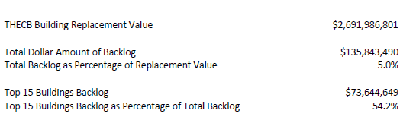
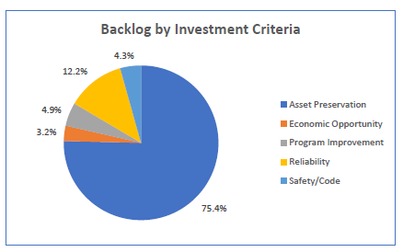
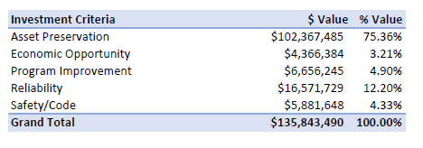
Supportive Data

Slide 9
Budget Request
#2 Budget Priority | Support of Mail Services
Aligned with Strategic Priority Goal | Goal 2.5 - Provide excellent and timely service to students, faculty, staff, visitors, and alumni
Amount Requested | $175,000
Frequency of Need | Recurring
Opportunity Statement | Mail Services was outsourced to Ricoh in 2020. This service is a connection between the students and their parents. It is an important customer service function of the university. Additionally, we utilize student employees to the extent possible which creates an additional touchpoint for the students.
Risk Statement | If mail services are not properly funded, then the reputation of SHSU could be damaged. However, more so, students would not have access to needed communication and materials.

Slide 10
Supportive Data
Mail Services
Outbound mail pieces processed—average of 14,000/month
Inbound mail pieces processed—average of 9,000/month
Bulk mail processed—average of 28,000/month
Delivery of approximately 2,000 packages/month to 4 locker banks across campus (250 lockers)
An average of 130 people per day visit the Katpost for various transactions, including the purchase of stamps, envelopes and other mail necessities and/or mailing packages via USPS, FedEx, or UPS

Slide 11
Budget Request
#3 Budget Priority
What is the request?
#3 Budget Priority | Human Resources Initiatives
Aligned with Strategic Priority Goal | Goal 2.3 - Provide a supportive, empowering, and culturally responsive workplace
Amount Requested | $70,000
Frequency of Need | Recurring
Opportunity Statement | This request allows us to maintain the required annual cost for criminal background checks (annual cost), software management for Title IX compliance, as well as initiatives such as the pilot employee recruitment referral program and the employee graduation ceremony. The first two items are critical to compliance and the second two items are important to recruit talented employees and to retain them.
Risk Statement | Because of the nature of this request, there are a variety of risks included, such as compliance (legal), operations, and reputational.

Slide 12
Budget Request
#4 Budget Priority
What is the request?
#4 Budget Priority | Campus Safety – Property Insurance Increases
Aligned with Strategic Priority Goal | Goal 2.2 - Align processes and resources, such as staffing, facilities, technology, and other assets to strategic priorities
Amount Requested | $150,000
Frequency of Need | Recurring
Opportunity Statement | As we increase the size of our physical campus, our property insurance also increases. It is important to protect this physical asset through property insurance.
Risk Statement | Without property insurance there is a financial risk if we suffered a large-scale incident.

Slide 13
Budget Request
#5 Budget Priority
What is the request?
#5 Budget Priority | Environmental Health & Safety – Hazardous Waste Disposal
Aligned with Strategic Priority Goal | Goal 2.5 - Provide excellent and timely service to students, faculty, staff, visitors, and alumni
Amount Requested | $65,000
Frequency of Need | Recurring
Opportunity Statement | One of the major challenges that EH&S has encountered in the management of hazardous chemical waste is the accumulation of previously identified wastes. These wastes were left in storage for an extended period and not properly disposed. Not only does this significantly increase the cost of disposal, but it hinders SHSU’s ability to comply with state regulations related to the management of hazardous waste
Risk Statement | The risk of not funding is that SHSU will be unable to sustainably dispose of these wastes as they are generated throughout the fiscal year.

Slide 14
Summary of Budget Requests
HEAF Facilities Investment– $ 8,000,000
Support of Mail Services– $ 175,000
Human Resources Initiatives– $ 70,000
Property Insurance Increases– $ 150,000
Hazardous Waste Disposal– $ 65,000
*Total Amount Requested – $8,460,000

Slide 15
Prospective “Big Ideas”
Increased attention to sustainability
Development of our employees
Create opportunities for the classroom to impact our physical campus
Construction of a light-upscale boutique hotel to support campus visitors
Physical spaces that draw the community and campus together

Slide 16
Questions?

